Slide 1
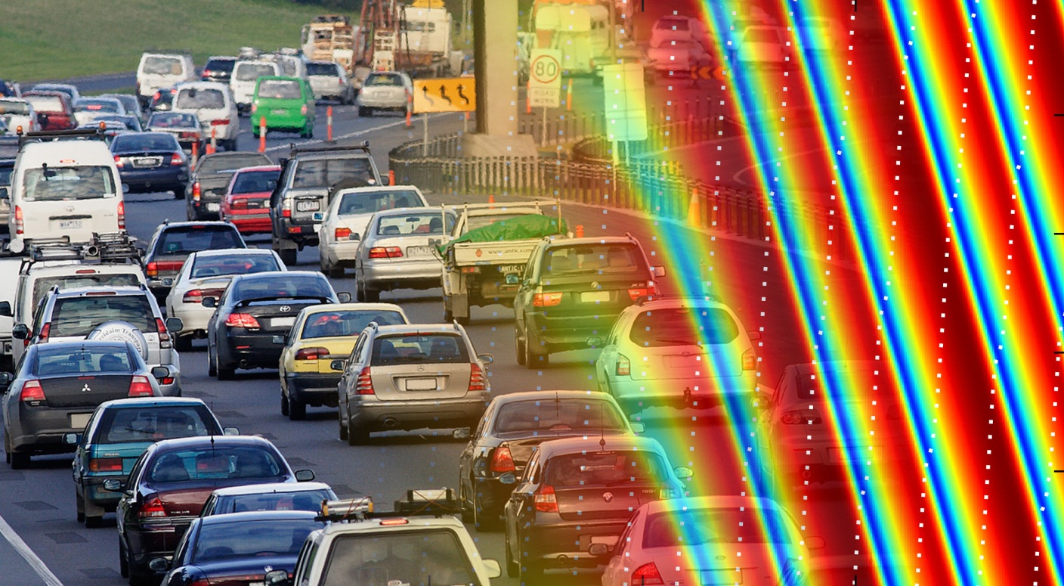
Phase transition in the Intelligent Driver Model induced by interaction exponent

Slide 2
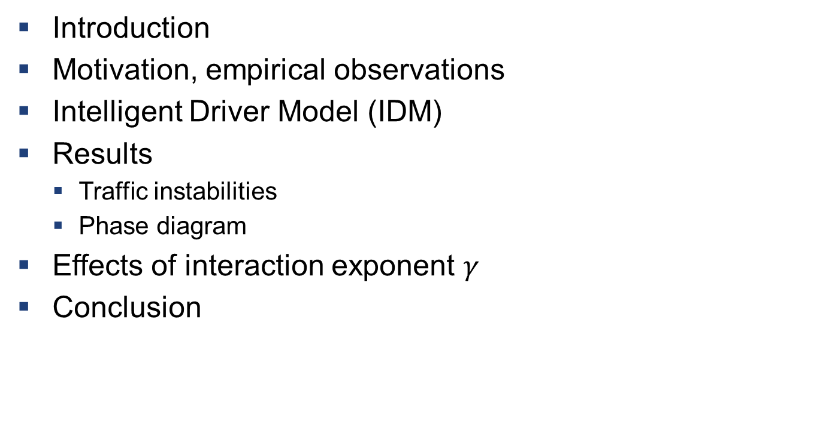
Overview
Introduction
Motivation, empirical observations
Intelligent Driver Model (IDM)
Results
Traffic instabilities
Phase diagram
Effects of interaction exponent $γ$
Conclusion

Slide 3
Introduction
We want to understand traffic dynamics
Existing computer models can emulate emergence of stop-and-go waves
How do acceleration and breaking strategies affect traffic stability?

Slide 4
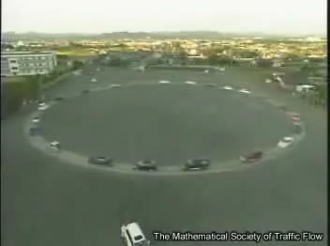
Experimental observation of instability
Nakayama et al. New Journal of Phys. 2009 [1]

Slide 5
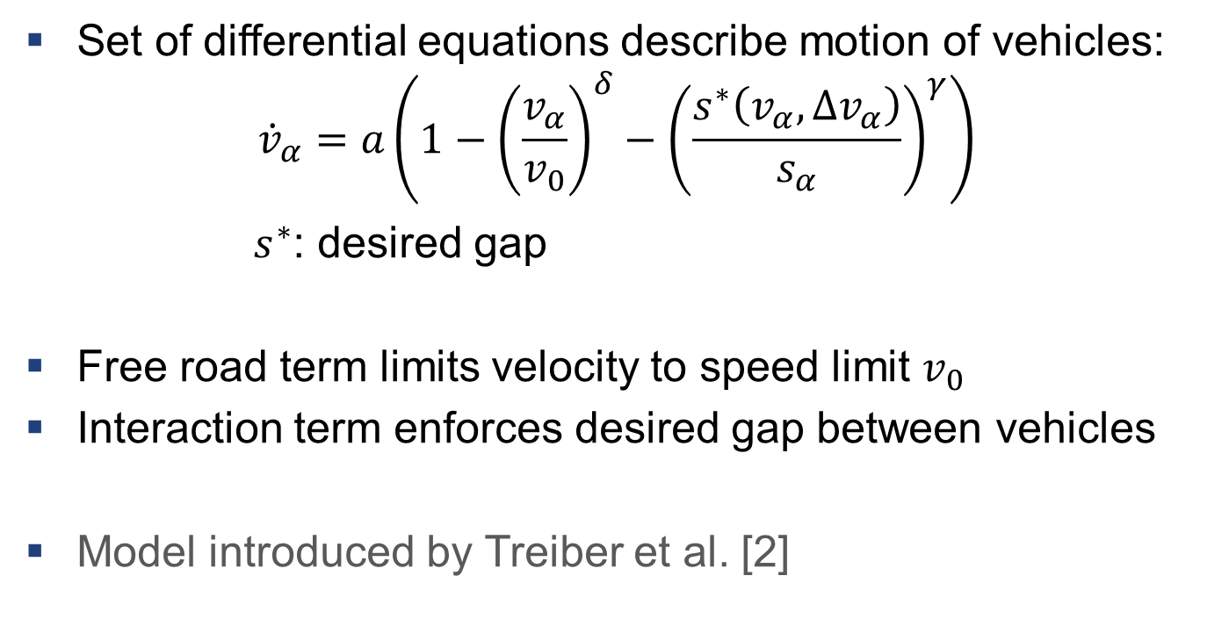
Intelligent Driver Model (IDM)
Set of differential equations describe motion of vehicles:
$${\dot{v}}_{α}=a\left(1−{\left(\frac{v_{α}}{v_{0}}\right)}^{δ}−{\left(\frac{s^{∗}\left(v_{α},Δv_{α}\right)}{s_{α}}\right)}^{γ}\right)$$
$s^{∗}$: desired gap
Free road term limits velocity to speed limit $v_{0}$
Interaction term enforces desired gap between vehicles
Model introduced by Treiber et al. [2]

Slide 6
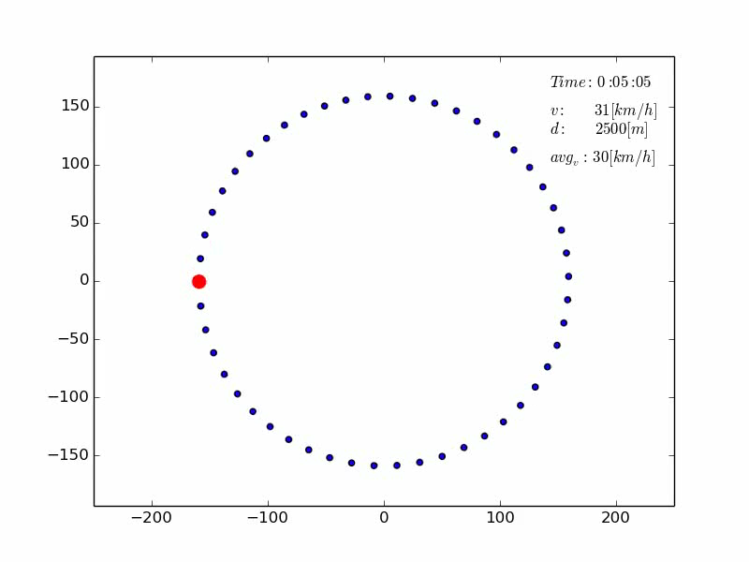
Simulated traffic instability

Slide 7
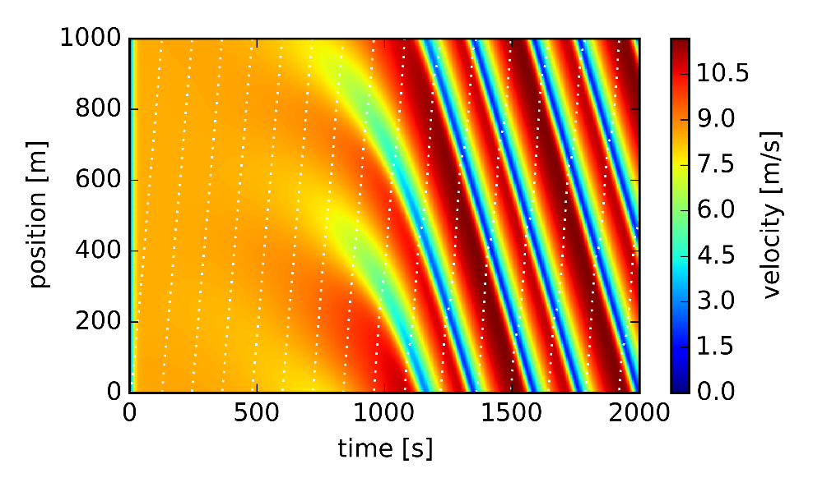
Simulated traffic instability
Traffic flow initially evolves homogeneously
Spontaneous rise of the instabilities
Instabilities manifest in the form of stop-and-go waves
Stop-and-go waves travel opposite to the vehicle flow
Instability is equilibrium condition
Spatio-temporal representation of velocity distribution

Slide 8
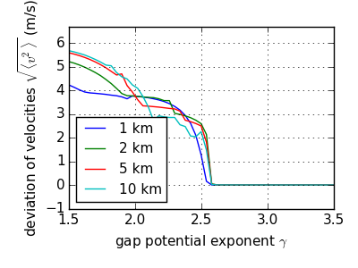
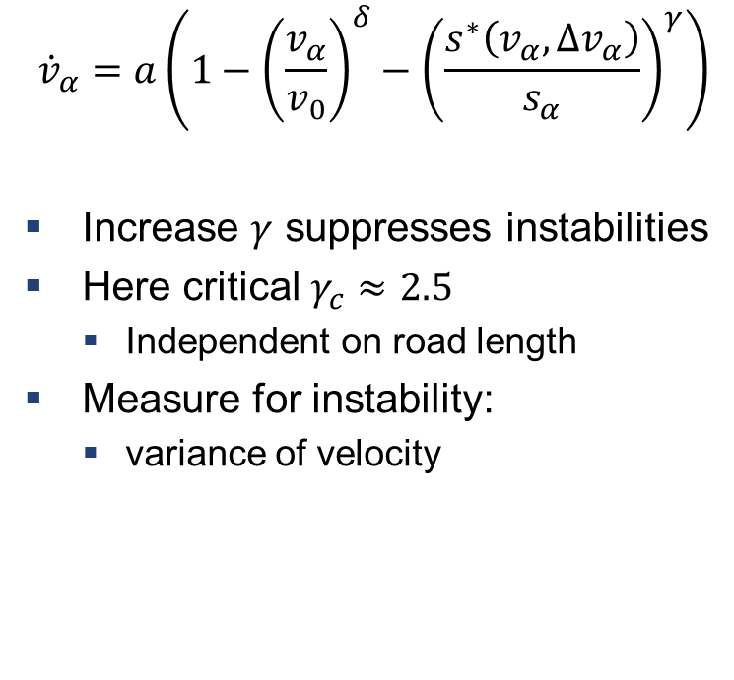
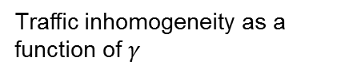

Interaction exponent $γ$
$${\dot{v}}_{α}=a\left(1−{\left(\frac{v_{α}}{v_{0}}\right)}^{δ}−{\left(\frac{s^{∗}\left(v_{α},Δv_{α}\right)}{s_{α}}\right)}^{γ}\right)$$
Increase $γ$ suppresses instabilities
Here critical $γ_{c}≈2.5$
Independent on road length
Measure for instability:
variance of velocity
Traffic inhomogeneity as a function of $γ$

Slide 9
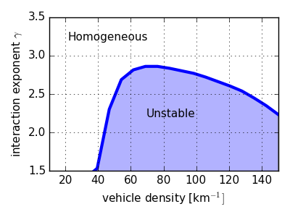

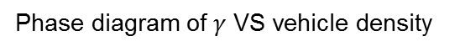
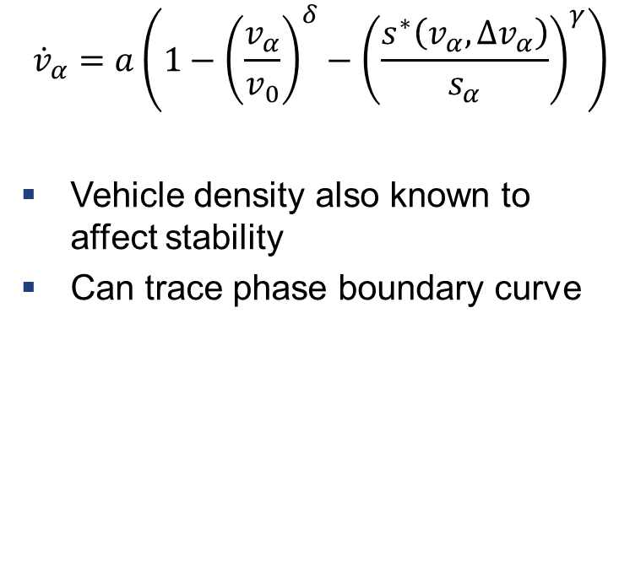
Interaction exponent $γ$: phase diagram
$${\dot{v}}_{α}=a\left(1−{\left(\frac{v_{α}}{v_{0}}\right)}^{δ}−{\left(\frac{s^{∗}\left(v_{α},Δv_{α}\right)}{s_{α}}\right)}^{γ}\right)$$
Vehicle density also known to affect stability
Can trace phase boundary curve
Phase diagram of $γ$ VS vehicle density

Slide 10


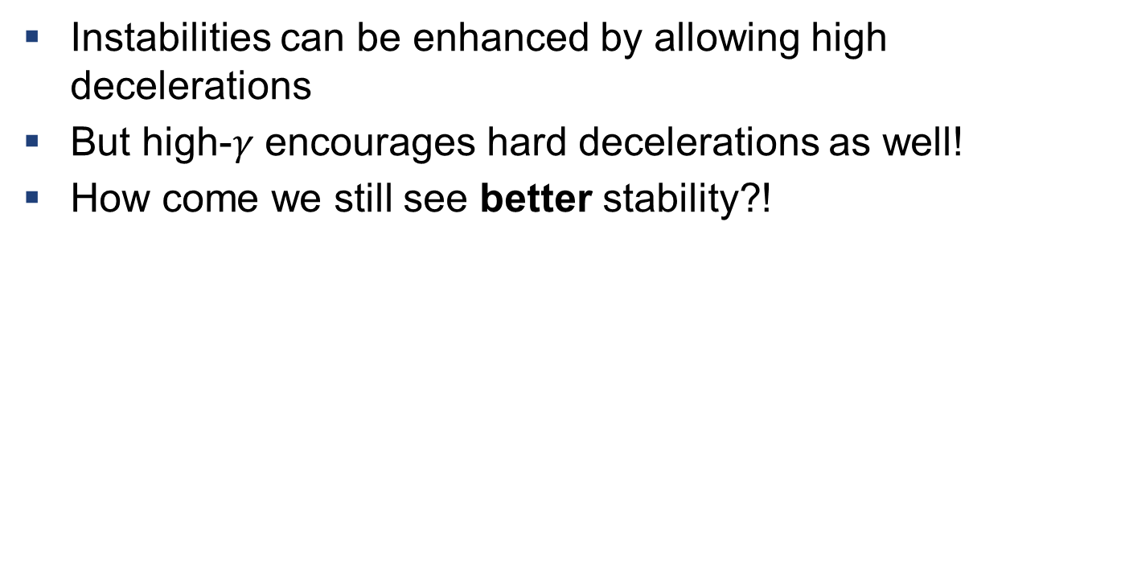
Exponent $γ$ affects stability, but why?
Instabilities can be enhanced by allowing high decelerations
But high-$γ$ encourages hard decelerations as well!
How come we still see better stability?!

Slide 11
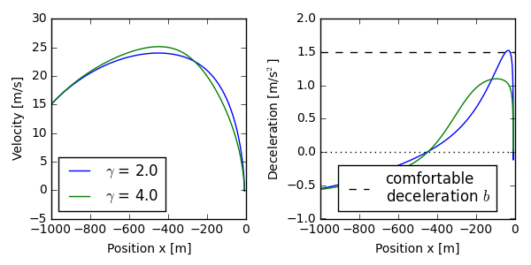

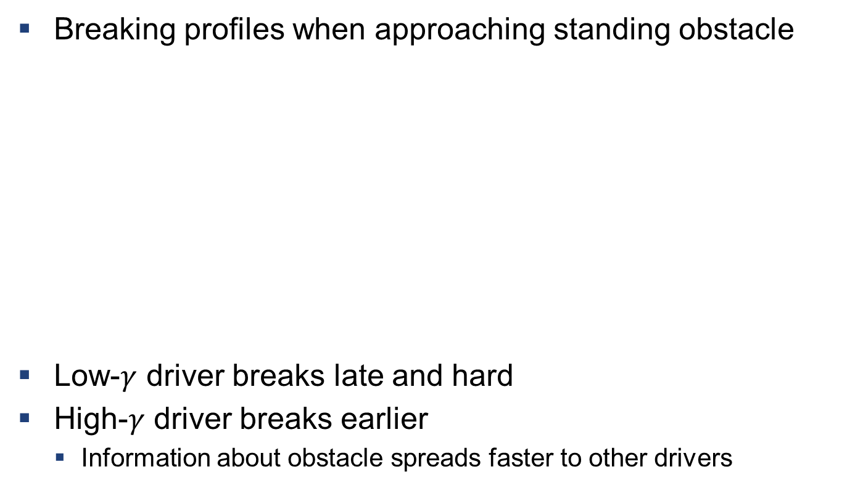
Breaking behaviour
Breaking profiles when approaching standing obstacle
Low-$γ$ driver breaks late and hard
High-$γ$ driver breaks earlier
Information about obstacle spreads faster to other drivers

Slide 12
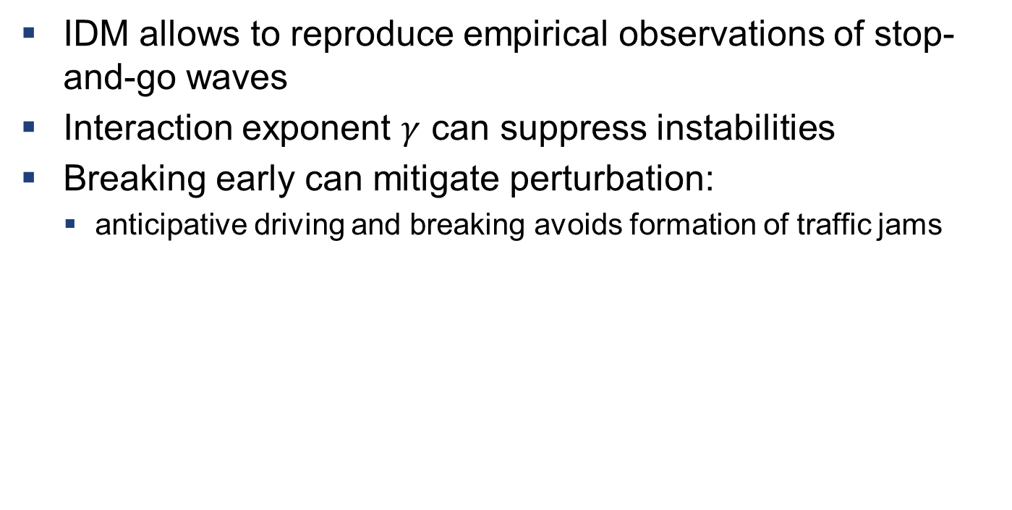
Conclusions
IDM allows to reproduce empirical observations of stop-and-go waves
Interaction exponent $γ$ can suppress instabilities
Breaking early can mitigate perturbation:
anticipative driving and breaking avoids formation of traffic jams

Slide 13
References
[1] Nakayama et al. Metastability in the formation of an experimental trac jam. New Journal of Physics, 11(8):083025, 2009.
[2] Martin Treiber and Dirk Helbing. Explanation of observed features of self-organization in traffic flow. arXiv preprint cond-mat/9901239, 1999.

